Slide 1
Binary Search
Lecture 5

Slide 2
Binary Seach
A simple approach is to do linear search. The time complexity of this algorithm is O(n). Another approach to perform the same task is using Binary Search.
Binary Search: Search a sorted array by repeatedly dividing the search interval in half. Begin with an interval covering the whole array. If the value of the search key is less than the item in the middle of the interval, narrow the interval to the lower half. Otherwise narrow it to the upper half. Repeatedly check until the value is found or the interval is empty.

Slide 3
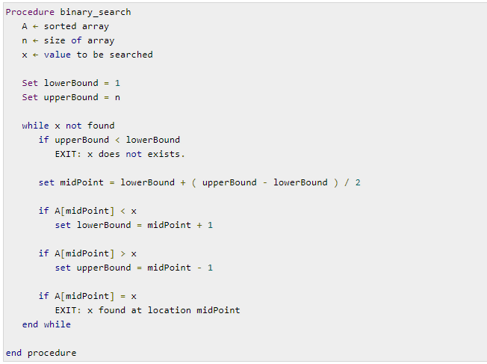
Pseudo code

Slide 4
C Code
void search(const int a[ ], size_t first, size_t size, int target, bool& found, size_t& location)
{
size_t middle;
if(size == 0) found = false;
else {
middle = first + size/2;
if(target == a[middle]){
location = middle;
found = true;
}
else if (target < a[middle])
// target is less than middle, so search subarray before middle
search(a, first, size/2, target, found, location);
else
// target is greater than middle, so search subarray after middle
search(a, middle+1, (size-1)/2, target, found, location);
}
}

Slide 5
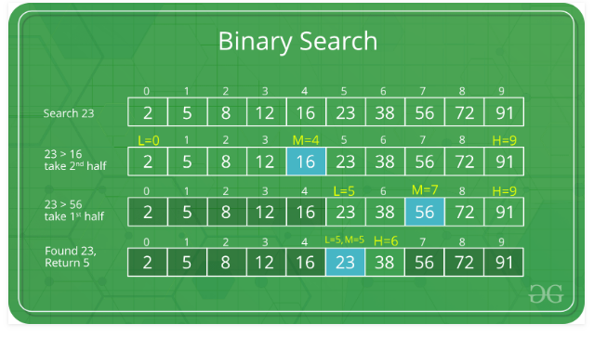
Example

Slide 6
Relation to Binary Search Tree
Array of previous example:
3
6
7
11
32
33
53
Corresponding complete binary search tree
11
6
33
3
7
32
53

Slide 7
Search for target = 7
Find midpoint:
3
6
7
11
32
33
53
Start at root:
11
6
33
3
7
32
53

Slide 8
Search for target = 7
Search left subarray:
3
6
7
11
32
33
53
Search left subtree:
11
6
33
3
7
32
53

Slide 9
Search for target = 7
Find approximate midpoint of subarray:
3
6
7
11
32
33
53
Visit root of subtree:
11
6
33
3
7
32
53

Slide 10
Search for target = 7
Search right subarray:
3
6
7
11
32
33
53
Search right subtree:
11
6
33
3
7
32
53

Slide 11
Binary Search: Analysis
Worst case complexity?
What is the maximum depth of recursive calls in binary search as function of n?
Each level in the recursion, we split the array in half (divide by two).
Therefore maximum recursion depth (log₂n) and worst case = O(log₂n).
Average case is also = O(log₂n).

Slide 12
if(size == 0) found = false;
else {
middle = first + size/2;
if(target == a[middle]){
location = middle;
found = true;
}
else if (target < a[middle])
search(a, first, size/2, target, found, location);
else
search(a, middle+1, (size-1)/2, target, found, location);
}
1 unit time
n/2

Slide 13
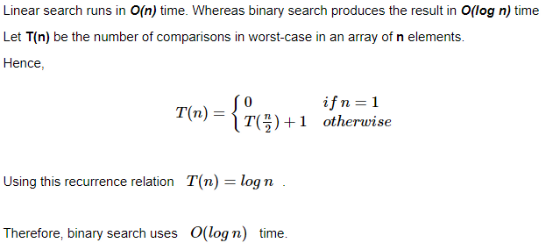
Analysis

Slide 14
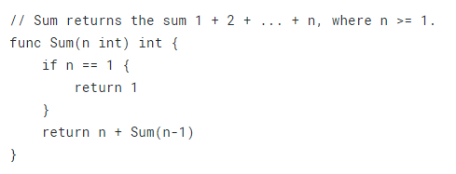
Complexity of Recursive Functions

Slide 15
Let the function T(n) denote the number of elementary operations performed by the function call Sum(n).
We identify two properties of T(n).
Since Sum(1) is computed using a fixed number of operations k₁, T(1) = k₁.
If n > 1 the function will perform a fixed number of operations k₂, and in addition, it will make a recursive call to Sum(n-1). This recursive call will perform T(n-1) operations.
In total, we get T(n) = k₂ + T(n-1).
If we are only looking for an asymptotic estimate of the time complexity, we don’t need to specify the actual values of the constants k₁ and k₂. Instead, we let k₁ = k₂ = 1.
To find the time complexity for the Sum function can then be reduced to solving the recurrence relation
T(1) = 1,
T(n) = 1 + T(n-1), when n > 1.

Slide 16
By repeatedly applying these relations, we can compute T(n) for any positive number n.
T(n) = (**)
1 + T(n-1) = (**) 1 + (1 + T(n-2)) = 2 + T(n-2) = (**) 2 + (1 + T(n-3)) = 3 + T(n-3) = …
k + T(n-k) = … n - 1 + T(1) = (*)
n - 1 + 1= Θ(n)

Slide 17
Binary search
Once again, we simplify the problem by only computing the asymptotic time complexity, and let all constants be 1. Then the recurrences become
T(1) = 1,
T(n) = 1 + T(n/2), when n > 1.
Once again, it’s possible to find a solution by repeated substitution.
T(n) = (**) 1 + T(n/2) = (**) 1 + (1 + T(n/4)) = 2 + T(n/4) = (**) 2 + (1 + T(n/8)) = 3 + T(n/8) = ...
k + T(n/2^{k}) = ...
log n + T(n/2^{log n}) = log n + T(1)
log n + 1 = Θ(log n).
Let's set the original statement equal to y. y=2log^n Now, we can apply log base 2 to each side. log2 y=log2 ⁡2log^⁡n Using the previously stated property of log, log2 y=log2 nlog2 2 Log base b of b will always equal 1. log2 y=log2 ⁡n Therefore, y=n

Slide 18
END

